Slide 1
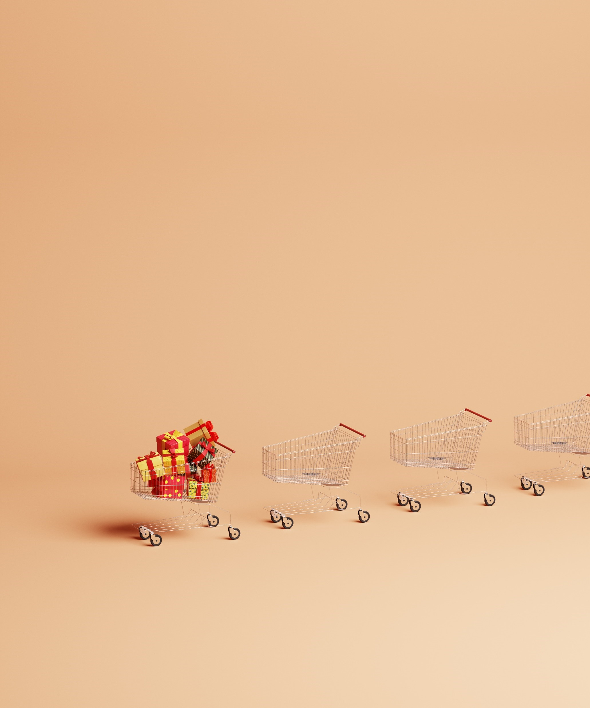

Christmas Reviews with your Convenience Tracking Programme
Christmas 2023

Slide 2

YOY growth in all KPIs vs last Christmas
YOY Penetration, Spend, Frequency & Basket Size
Christmas in convenience 2023 saw penetration and spend growth vs 2022 and 2021, whilst frequency and basket size were also up vs last year.
In 2023, Average Spend saw a growth of 24% vs. last year, largely driven by cost-of-living increases and more premium offerings within convenience retailers.
Source: Lumina Intelligence Convenience Tracking Programme, w/e 27/12/20, 26/12/21, 25/12/22, 24/12/23

Slide 3






Symbols & Independents gain market share in 2023
Channel share of occasions
Retailers with largest share growth Christmas 2022 vs 2023
+1.4ppts
+1.2ppts
+0.7ppts
+0.7ppts
+0.7ppts
+0.4ppts
Source: Lumina Intelligence Convenience Tracking Programme, 6w/e 27/12/20, 6w/e 26/12/21, 6w/e 25/12/22, 6w/e 24/12/23

Slide 4
Chilled & Frozen Categories saw biggest YOY growth
Top 15 Category Drivers to Store
e.g. % shoppers that said bakery was the main reason they went to store
+4ppts
-3ppts
-1ppts
The percentage of shoppers saying Chilled and Frozen categories were the main reason they went to store grew from 2022 to 2023. This was largely driven by categories such as Fresh Fruit, Fresh Meat but also Chilled & Frozen Pizza. Soft Drinks & Alcohol saw the biggest YOY decline as shoppers opted for more food focused reasons to visit.
+1ppts
Source: Lumina Intelligence Convenience Tracking Programme, 2w/e 01/01/23 & 2w/ 31/12/23

Slide 5
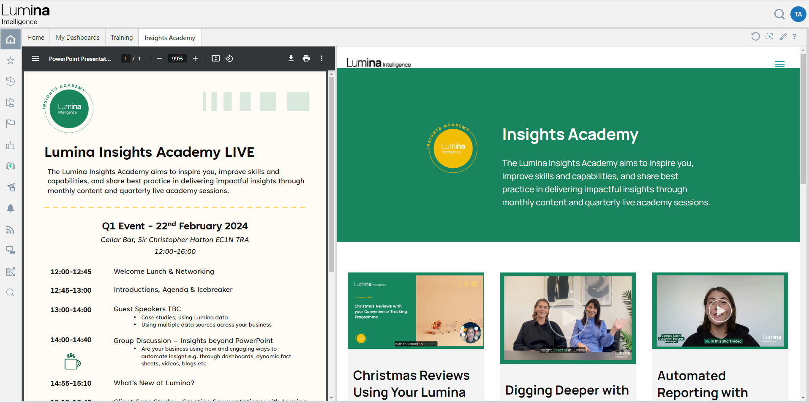
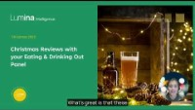
How to take this analysis further
On the next slide, you will see my recommendations on the dimensions in your Convenience Tracking Programme that would be valuable to analyse across the Christmas time periods.
You can also watch a video of me explaining how to use the Christmas time periods in our WHEN-Events & Seasons dimension: https://www.lumina-intelligence.com/insights-academy/christmas-reviews-using-your-lumina-subscription/
This is also available on your landing page when you log in through ‘My Dashboards’. Navigate to the ‘Insights Academy’ tab:

Slide 6
My suggestions of what to look at next in CTP
Use the WHEN-Events & Seasons dimension to access the Christmas Periods.
Category
Delivery
Missions
Shopper
Own Label purchasing using CATEGORY-Brand Purchased
Top Categories purchased at Christmas using WHAT-Basket Analysis
Most popular soft drinks/crisps/chocolate formats purchased at Christmas using CATEGORY – Pack Size and CATEGORY – Sub-category Analysis
Growth/decline in Promo and PMP purchasing using WHAT-Promotional Purchase and WHAT- PMP Purchases
Share of delivery occasions using HOW-Buying Method
Most used delivery company using WHAT-Delivery Company used
Average spend on Delivery Apps using HOW-Buying Method and WHAT-Spend on Shop Items Av from the measures
Which shoppers have driven the growth of delivery using HOW-Buying Method and WHO-Age
Buying method by category using HOW-Buying Method and WHAT-Basket Analysis
Mission share & growth using WHAT-Missions
Mission share by top 5 largest categories using WHAT-Mission and WHAT-Basket Analysis
Which shoppers are driving mission growth using WHAT-Missions and WHO-Age, Who-Social Grade
Share of purchases by age for your category using WHAT-Basket Analysis and WHAT-Age
Shopper attitudes towards your category/NPD at Christmas using WHO-Attitude-Likes trying new things for example
Consumer psychographics to see if consumers were more valued led this Christmas using WHO-Psychographics
Reduction in shoppers drinking Alcohol this Christmas using WHO-Drinks Alcohol

Slide 7
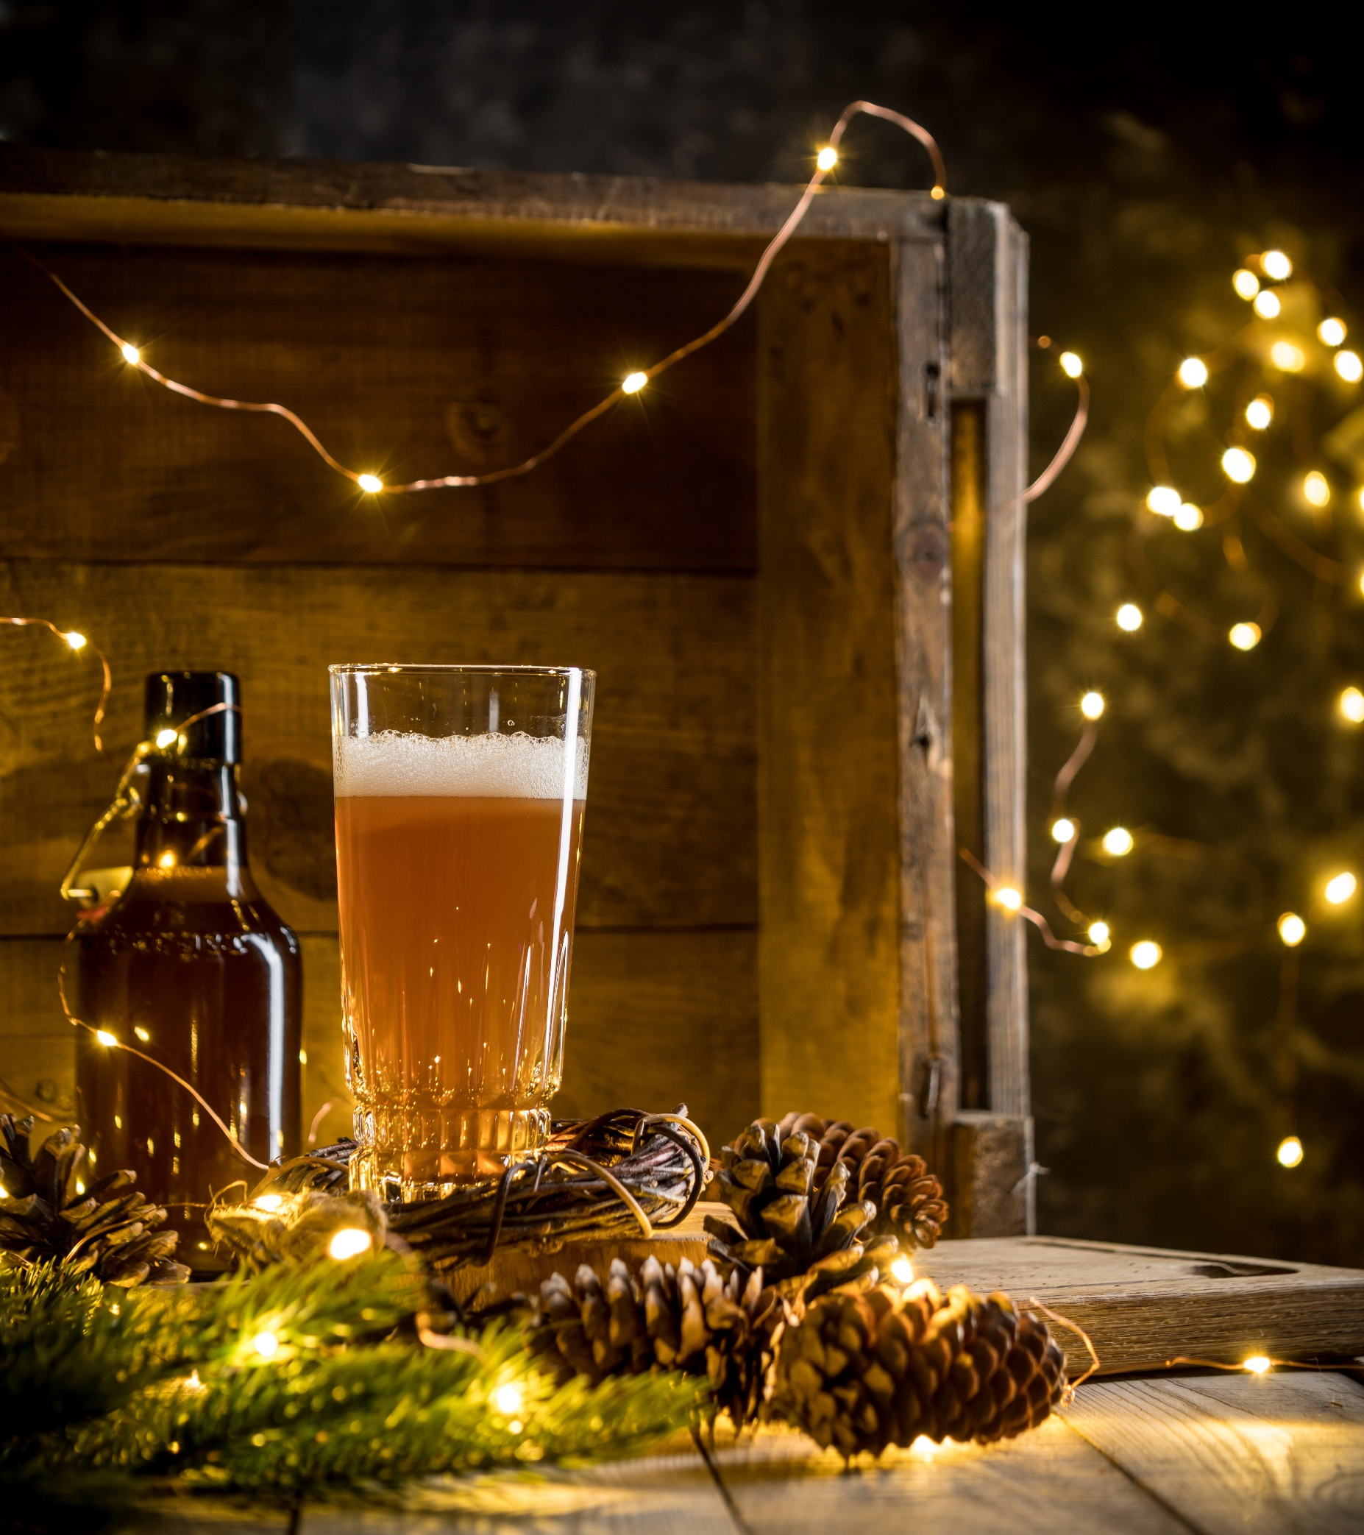
Christmas Reviews with your Eating & Drinking Out Panel
Christmas 2023

Slide 8
40% YOY growth in OOH spend vs last Christmas
Year of Year Penetration, Spend & Frequency
Christmas in OOH 2023 saw penetration remain stable vs last Christmas, whilst average spend on food & drink and frequency increased. Despite higher prices due to cost-of-living, consumers traded up to more expensive drinks this Christmas including Spirits and Cocktails
Source: Lumina Intelligence Eating & Drinking Out Panel, w/e 27/12/20, 26/12/21, 25/12/22, 24/12/23

Slide 9
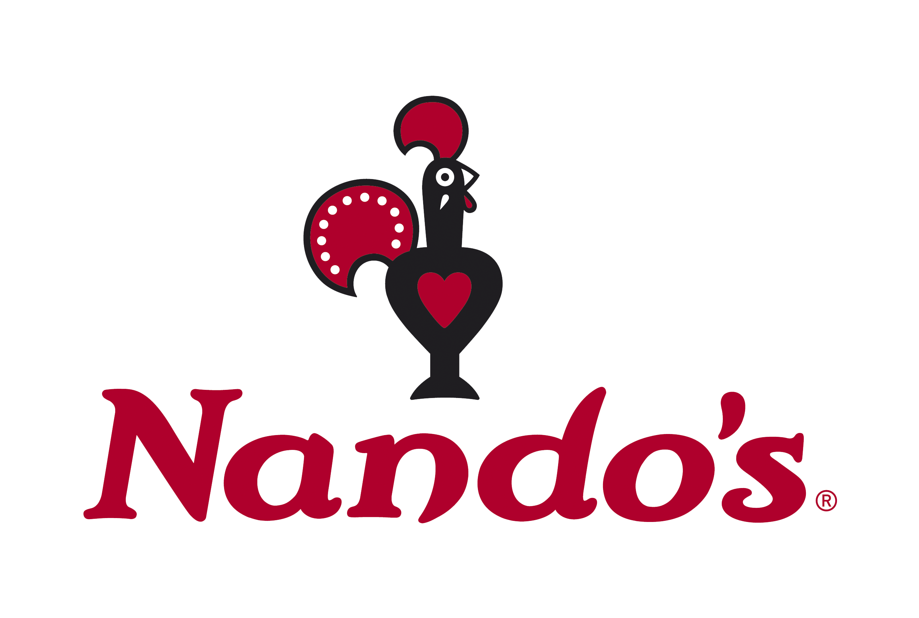


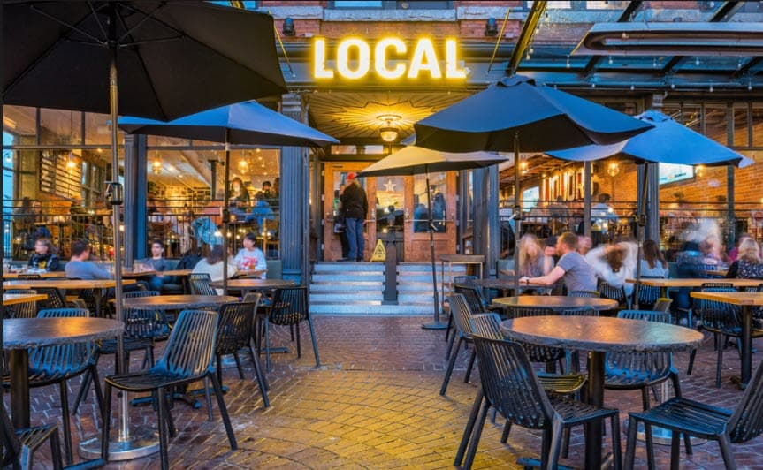
Restaurants gain market share in 2023
Channel share of occasions
Restaurant brands with largest share growth Christmas 2022 vs 2023
+4ppts
+1.8ppts
+0.8ppts
-4ppts
Source: Lumina Intelligence Eating & Drinking Out Panel, 6w/e 27/12/20, 6w/e 26/12/21, 6w/e 25/12/22, 6w/e 24/12/23

Slide 10
Pub favourites lose share & beer remains no.1 choice
Top 10 Dishes Ordered
Alcoholic Drinks
+1.9ppts
+3.1ppts
+0.6ppts
+5.3ppts
Source: Lumina Intelligence Eating & Drinking Out Panel , 2w/e 01/01/23 & 2w/ 31/12/23

Slide 11
How to take this analysis further
On the next slide, you will see my recommendations on the dimensions in your Eating & Drinking Out Panel that would be valuable to analyse across the Christmas time periods.
You can also watch a video of me explaining how to use the Christmas time periods in our WHEN-Events & Seasons dimension: https://www.lumina-intelligence.com/insights-academy/christmas-reviews-using-your-lumina-subscription/
This is also available on your landing page when you log in through ‘My Dashboards’. Navigate to the ‘Insights Academy’ tab:

Slide 12
My suggestions of what to look at next in EDOP
Use the WHEN-Events & Seasons Dimension to access the Christmas Periods.
Channel & Brand
Delivery
Missions/Occasions
Shopper
Brand share of Channel using WHERE-Brand and WHERE-Channel
Average Spend on Total, Food & Drink by Channel using WHERE-Channel and WHAT – Spend Total, WHAT – Spend – Food, WHAT – Spend – Drink
Reasons for growth in specific brands by using WHY-Reason for choosing establishment and WHERE-Brand
Which shoppers are driving growth in each channel using WHERE-Channel and WHO-Age, WHO-Social Grade and WHO-Gender
Share of delivery occasions using HOW-Buying Method
Most used delivery company using HOW-Delivery Company used
Average spend on Delivery Apps using HOW-Buying Method and WHAT-Spend Total from the measures
Which shoppers have driven the growth of delivery using HOW-Buying Method and WHO-Age, WHO-Social Grade
Buying method by dishes using HOW-Buying Method and WHAT-Dishes
Mission share & growth using WHY – Reason for eating out vs preparing food/drink at home
Use WHY-Occasion to look at the growth in occasions such as socialising and celebration at Christmas
Share of OOH Occasions by Group Composition using WHO-Group Composition
Consumers purchasing just food, just drink or both using WHAT – Food-Drinks Bought
Consumer Psychographics e.g. did value consumers gain share at Christmas using WHO-Psychographics. Use this to compare the Christmas period vs rest of year
Day-part share of occasions using WHAT-Day Part and WHERE-Channel

