Slide 1
UK Convenience Market Report 2021
Report sample and table of contents

Slide 2
Consumers are visiting convenience stores most frequently
Peak Lockdown I – III
Consumers are visiting convenience stores on average twice a week, a slight fall from a peak of 2.2 times per week seen throughout the past year. Online grocery frequency has fallen to the lowest frequency in 13 months with easing restrictions boosting confidence among consumers to venture out of the house for grocery shopping. Little and often convenience shopping will help consumers manage spend whilst limiting food waste.
Average number of visits per store per week
Lockdown I
Lockdown II
Lockdown II
Source: Lumina Intelligence Channel Pulse data collected 23/03/20 – 16/05/21

Slide 3
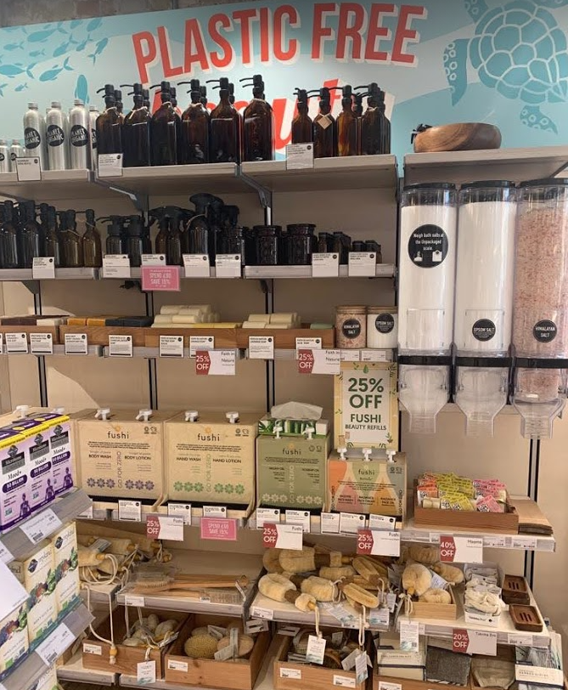
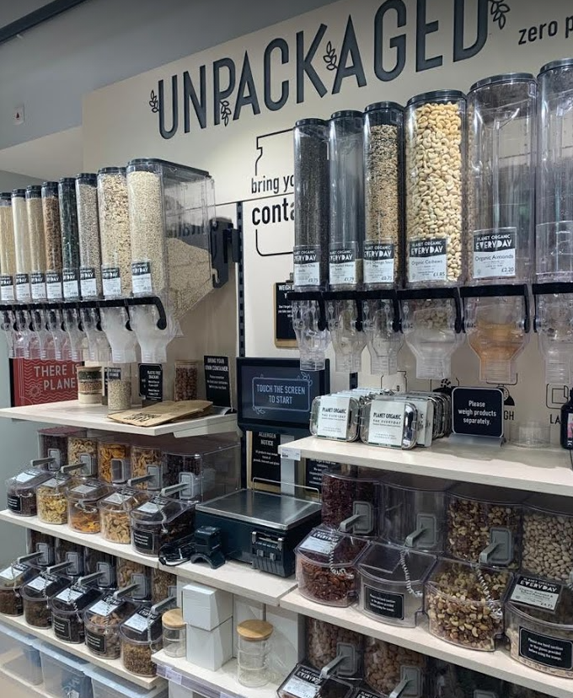
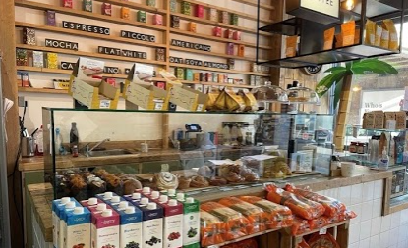
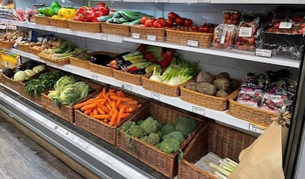
Premium convenience concepts focus on sustainability
Post Lockdown III
Premium neighbourhood convenience concepts are offering consumers packaging free essentials as well as deli items and barista coffee.
Planet Organic, Queens Park, London
Raw Store, Shoreditch, London
Source: Lumina Intelligence, July 2021

Slide 4
Delivery shoppers are more brand-led
Post Lockdown III
Offering a range of branded products as part of a delivery service will increase attractiveness as delivery shoppers are more brand-led. Similarly, delivery shoppers are more open to paying a price premium for higher quality food which suggests potential for offering premium ranges.
In-store shoppers vs. Delivery shoppers
1 – “That’s not me at all”
“I like buying branded products”
4.3
6 – “Yes, that’s me!”
4.1
“I am happy to pay more for higher quality food/drinks”
4.5
4.3
Source: Lumina Intelligence Convenience Tracking Programme 28 WE 30/05/21

Slide 5
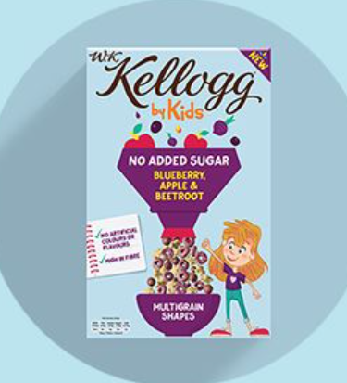


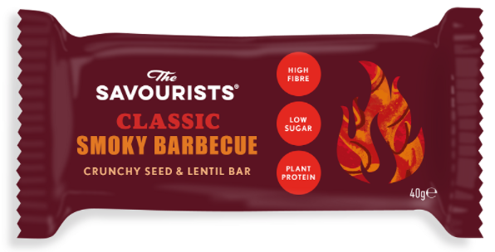
Suppliers take different reformulation approaches
Post Lockdown III
Suppliers are taking different approaches to complying with HFSS regulations, ranging from using alternative ingredients to boost nutritional content to repositioning newly launched products as healthier alternatives.
Using savoury ingredients to improve nutritional content
Reducing sugar and salt content
Using a new ingredient as snacking alternative
Repositioning snacks with ‘better for you’ versions
The Savourists make snacks by using savoury ingredients such as roasted lentils in combination with grains including quinoa and sunflower seeds.
Kellogg’s has pledged to cut sugar by 10% and salt by 20% in its children’s cereal range by 2022. All of its breakfast foods will either be a source of or high in fiber by the end of 2023.
Karma Bites has developed a line of Popped Lotus Seed snacks which are gluten free and vegan. The range is low in calories, cholesterol, fat, and sodium.
Simply Roasted has unveiled a new range of ‘better for you’ crisps which provide 50% less fat, less salt and only 99 calories. The brand is launching traditional flavours first, before an extended range which will be have an Asian cuisine twist - Korean BBQ, Katsu Curry and Thai Green Curry.
Source: Lumina Intelligence, July 2021

Slide 6
Suburban migration a lasting legacy of pandemic
Post Lockdown III
The pandemic traded lifestyle norms for home-working, local-living and a ‘chase for outdoor space’ as there was a max exodus from cities. This hyper-localism has enabled shoppers to reconnect with communities, supported by the Lumina Intelligence Future of Convenience Report 2021 which found that 53% have shopped locally more in the last year and 42% will continue to shop locally in the future.
Supporting local suppliers and retailers is either ‘very important’ or ‘important’ to them
As Coronavirus restrictions begin to ease, how often do you anticipate that you will be working from home in the next 12 months?
34%
74% say it’s either ‘important’ or ‘very important’ to support businesses who give back to the community
Plan to WFH
Don’t want to WFH/ Can’t WFH/ Not working/ Don’t know
Looking ahead post-pandemic, over a third (34%) of consumers anticipate working from home in some capacity as restrictions begin to ease. This is changing the locational focus of retailers as home working continues to impact city centre footfall. Office occupancy levels hit 50% of pre-pandemic levels for the first time since March 2020 in May 2021.
Source: Lumina Intelligence Future of Convenience Bespoke Survey 2020 , Food to Go Bespoke Survey 2021 and Property Week

Slide 7
FULL REPORT TABLE OF CONTENTS
Executive summary
Convenience Market Context
K-shaped recovery means mixed fortunes
Convenience market developments, 1995-2021
UK GDP growth, 2018-2022F
UK inflation and wage growth, 2016-2021
Bank of England base interest rates, 2007-2021
Consumer Confidence April 2020 - June 2021
Key metrics impacting convenience
Barclaycard Consumer Spending Reports, April 2020-April 2021
How has the pandemic impacted your financial situation? (by age demographic)
% of shoppers who visited channel in last 7 days
Average number of visits per store per week
Predicted channel opportunity
Key external developments impacting the sector
Key trends impacting the convenience market

Slide 8
TABLE OF CONTENTS
Convenience Market Performance
Convenience market segment definitions
Convenience market value growth in 2020 (by sub-segment)
Convenience market value forecasts in 2021 (by sub-segment)
Convenience market growth by outlets and value 2018-21F
Turnover growth by sub-segment 2018-21F
Sub-segment share of convenience market value, 2018 & 2021F
Convenience market drivers, 2021
Convenience market inhibitors, 2021

Slide 9
TABLE OF CONTENTS
Competitive Landscape
Key Retailer Developments June 2020 - June 2021
Top 10 convenience fascias by turnover to Dec-20 (m)
Top 10 convenience fascias by outlets to Dec-20
Top 10 convenience fascias by outlets to Dec-21F
Top 10 fascia profiles by outlets (1 of 5)
Top 10 fascia profiles by outlets (2 of 5)
Top 10 fascia profiles by outlets (3 of 5)
Top 10 fascia profiles by outlets (4 of 5)
Top 10 fascia profiles by outlets (5 of 5)
Top 10 symbol fascias by outlets to Dec-21F
Top 5 convenience multiple fascias by outlets, Dec 20-Dec-21F
Top 10 fastest growing by outlets to Dec-21F
Key retailer range and store developments
Best In class on-site Concessions

Slide 10
TABLE OF CONTENTS
Shopper Overview & Demographics
Average shopper basket spend, visit frequency and basket size (Managed convenience vs symbols & independents)
Shopper penetration and average basket spend, visit frequency and basket size by age
Convenience shopper demographic (age, social grade, living situation)
Top 15 shopper missions within convenience
Top shopper missions by age
Food to go mission by age
A focus on 25-34 year olds in convenience
Top drivers to convenience stores
Top drivers to convenience stores (Managed convenience vs symbols & independents)
Top 10 category drivers to store
Top 10 categories bought
Top categories purchased on impulse and reasons for impulse purchasing
Top categories purchased on impulse (Managed convenience vs symbols & independents)
Top categories for PMP purchases
Impulse and PMP purchases by age
Top categories purchased on promotion (by age)
Shopper importance factors
The psychographics of convenience shoppers

Slide 11
TABLE OF CONTENTS
A Focus On: On Demand Convenience
Delivery’s share of total convenience retail occasions
In-store shopper vs. delivered shopper (basket spend, basket size and visit frequency)
In-store shopper vs. delivered shopper (age, gender, social grade)
Regional share: in-store vs. delivery
Delivery app brand awareness (by age)
In-store shoppers vs. delivery shoppers (importance of brand and price)
Delivery shopper dietary requirement over-indexes
Shopper missions - delivery shopper vs. in-store shopper
Top 10 delivered purchases
Shopper satisfaction - areas for improvement
What will the role of delivery play in the future?

Slide 12
TABLE OF CONTENTS
A Focus On: HFSS
What is the HFSS regulation?
Which categories are impacted and which face the biggest risk?
Top five promotional purchases in convenience
% of shoppers picking up a purchase at a specific store location i.e. display at the till
A spotlight on the impact of HFSS on the crisps & snacks category
A spotlight on the impact of HFSS on the confectionery category
A spotlight on the impact of HFSS on the soft drinks category
How to mitigate the impact of HFSS on impulse categories
HFSS categories opportunity in food & snack to go
Extra space allows for new category opportunities
Supplier focus: suppliers take different reformulation approaches

Slide 13
TABLE OF CONTENTS
A Focus On: Locational Analysis
Suburban migration a lasting legacy of pandemic
Leading retailers and operators rethink strategies
Convenience channel - Store location share of occasions
Locational demographic shopper profiles
Main shopper missions, by store location
Time in store, basket spend, basket size and visit frequency by store location
Top category over-indexes compared to convenience average
Top categories bought on impulse, by store location
Top categories bought on promotion, by store location
Top categories bought as PMP, by store location
Dietary requirement, by store location
Psychographics, by store location (% of shoppers who align with values)
Shopper satisfaction ratings, by store location
Best-in-class store examples

Slide 14
TABLE OF CONTENTS
Future Outlook
Convenience market value growth 2019-2024F
Future market drivers and inhibitors, 2021F-2024F
Healthier eating credentials will need to improve
Grocery delivery apps driving delivery uptake
The shift in balance between efficiency and service
The at-home & premium experience opportunity
City centre shopping shift
Iceland trials new swift store

Slide 15
Holly.franklin@lumina-intelligence.com or
Visit our website

